Slide 1
Bootstrap 3.1.1
Coder Foundry

Slide 2
Topics
Overview
Why use it?
Getting Started
Grid System
Layouts
CSS, Components, JavaScript

Slide 3
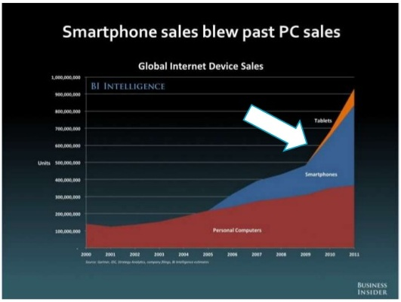
Overview
Framework for front-end development
Open source project from Twitter
Mobile-First approach
Responsive design

Slide 4
Why?
Other than mobile device dominance…
Faster development
Browser support
Number of devices
Ease of use
Customization
Price… or lack thereof

Slide 5
Getting Started
<!DOCTYPE html>
<html lang="en">
<head>
<meta charset="utf-8">
<meta http-equiv="X-UA-Compatible" content="IE=edge">
<meta name="viewport" content="width=device-width, initial-scale=1">
<title>Bootstrap 101 Template</title>
<!-- Bootstrap -->
<link href="css/bootstrap.min.css" rel="stylesheet">
<!-- HTML5 Shim and Respond.js IE8 support of HTML5 elements and media queries -->
<!-- WARNING: Respond.js doesn't work if you view the page via file:// -->
<!--[if lt IE 9]>
<script src="https://oss.maxcdn.com/libs/html5shiv/3.7.0/html5shiv.js"></script>
<script src="https://oss.maxcdn.com/libs/respond.js/1.4.2/respond.min.js"></script>
<![endif]-->
</head>
<body>
<h1>Hello, world!</h1>
<!-- jQuery (necessary for Bootstrap's JavaScript plugins) -->
<script src="https://ajax.googleapis.com/ajax/libs/jquery/1.11.0/jquery.min.js"></script>
<!-- Include all compiled plugins (below), or include individual files as needed -->
<script src="js/bootstrap.min.js"></script>
</body>
</html>

Slide 6
Grid System
Rows must be placed within a .container (fixed-width) for proper alignment and padding
Rows can be created via .row css class
Column css classes are used for creating columns in rows
Bootstrap grid system spans across 12 columns of screen

Slide 7
Grid System (continued)
.col-xs-1 CSS class
.container CSS class
.row CSS class

Slide 8
Grid System (continued)
Heading | Extra Small Devices (Phones) <768 px | Small Devices (Tablets) >= 768 px | Medium Devices (Laptops/Desktops) >=992 px | Large Devices (Desktops) >= 1200 px
Container class | None (auto) | 750 px | 970 px | 1170 px
Column class | .col-xs-* | .col-sm-* | .col-md-* | .col-lg-*
* represents a value between 1 and 12
Using col-md-* will apply the specified column layout to medium desktop and large devices, but not to extra small or small devices – that is, the smaller devices will use a vertical alignment
Using col-xs-* will apply the specified column layout on all devices

Slide 9
Grid System (continued)
Example:
<div class=”container”>
<div class="row">
<div class="col-md-6">
.col-md-6
</div>
<div class="col-md-6">
.col-md-6
</div>
</div>
</div>
Output:
.col-md-6 | .col-md-6

Slide 10
Layouts
 | Extra small devices (< 768 px) | Small devices (>=768 px) | Medium devices (>=992 px) | Large devices (>= 1200 px)
Grid behavior | Horizontal at all times | Collapsed to start, horizontal above breakpoints
Container width | None (auto) | 750px | 970px | 1170px
Class prefix | .col-xs- | .col-sm- | .col-md- | .col-lg-
# columns | 12
Column width | Auto | 60px | 78px | 95px
Gutter width | 30px (15px on each side of a column)

Slide 11
CSS, Components, JavaScript
CSS | Components | JavaScript
Typography | Glyph icons | Modal
Code | Breadcrumbs | ScrollSpy
Table | Pagination | Tooltip
Forms | Button Dropdowns | Popover
Buttons | Input Groups | Collapse
Images | Badges | Carousel
Helper Classes | Navigation Bar | Affix
Responsive Utilities | Jumbotron
 | Progress Bar
 | Alert
 | Panel

Slide 12
CSS, Components, Javascript (continued)
Resources:
www.getbootstrap.com
www.tutorialspoint.com/bootstrap
www.tutorialspark.com/twitterBootstrap/TwitterBootstrap_Modals.php

